Slide 1
School of Geography and Geology
McMaster University
Advanced Topics in Spatial Statistics
Session 16
Area Data II

Slide 2
This session
Bivariate analysis
Modeling area data
  Non-spatial regression models
Example: Modeling area data
Non-constant variance
  Data transformations
Error autocorrelation
  Moran’s I
Normality

Slide 3
Example
Voter turnout
  What explains voter turnout in elections?
What do we know about the data?
  Variables follow a spatial pattern (Spatial autocorrelation)
  Variables are probably correlated

Slide 4
Example
Voter turnout: Variables
  VOTE
  Voting age population (POP)
  Population with grade 12 or higher education (EDU)
  Number of owner occupied houses (HOUSE)
  Aggregate income (INCOME)
Unit of analysis: county

Slide 5
Example
Do we have prior expectations about the direction of the relationships?

Slide 6
Example
Bivariate analysis
  Scatterplots
  Correlation coefficients

Slide 7
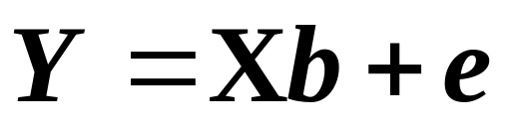
Example
Modeling area data
  Non-spatial regression
    Variables can be spatial
    Variables may be autocorrelated
    Assumes that there is no spatial autocorrelation
  Multiple regression

Slide 8
Modeling Area Data
Try different models
Model evaluation guidelines

Slide 9
Analysis of Residuals
Is variance constant?
  Scatterplot of errors vs. variables

Slide 10
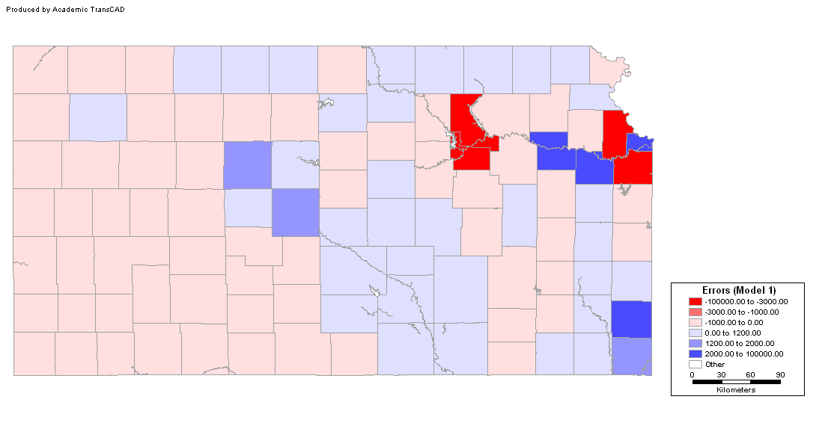
Analysis of Residuals
Are errors independent?
  Map of residuals

Slide 11
Analysis of Residuals
Are errors independent?
  Moran’s I
  Expected (mean) value of e is zero

Slide 12
Analysis of Residuals
Are errors normally distributed?
  Histogram
  Probability plot
  Other tests (Jaques-Bera, Kolmogorov-Smirnov,Lilliefors)

Slide 13
Modeling Area Data
What is the conclusion regarding this model?

Slide 14
Modeling Area Data
Data transformations
  May help to reduce size effects
  May increase the interpretability of the models

Slide 15
Modeling Area Data
Data transformations
  Instead of modeling totals, model the proportions
  Proportional voter turnout: VOTE/POP

Slide 16
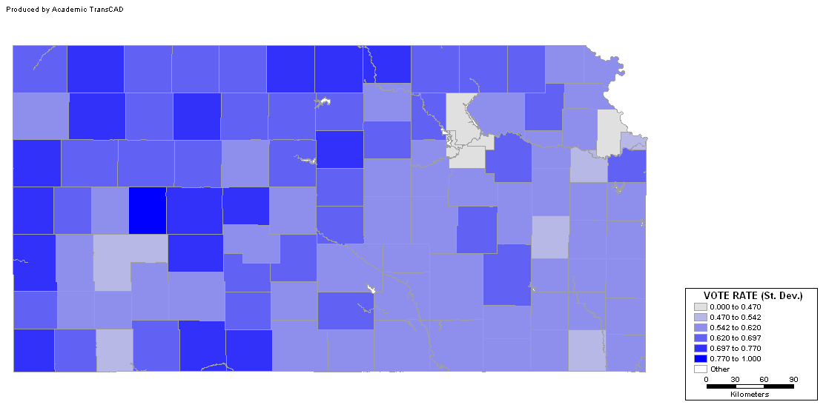
Exploring the Proportions
Choropleth map: PrVotes (Std. Dev.)
Notes:
What is the advantage of using standard deviations?

Slide 17
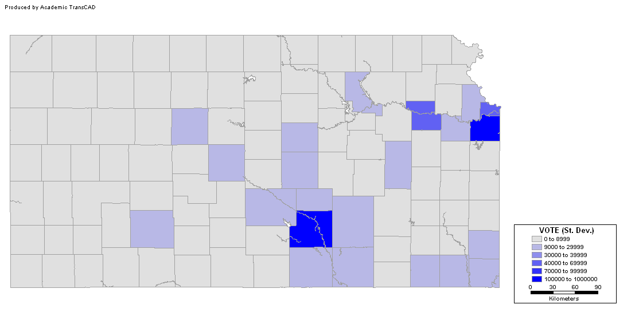
Exploring the Proportions
Choropleth map: Votes (Std. Dev.)
Notes:
What is the advantage of using standard deviations?

Slide 18
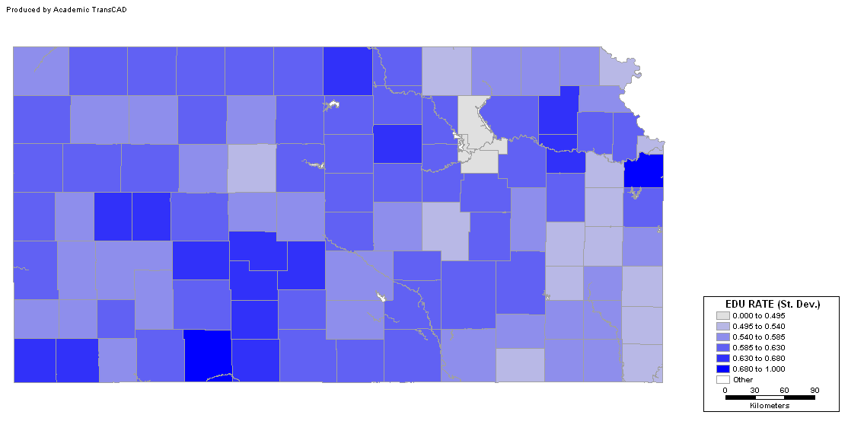
Exploring the Proportions
PrEDU (Std. Dev.)
Notes:
What is the advantage of using standard deviations?

Slide 19
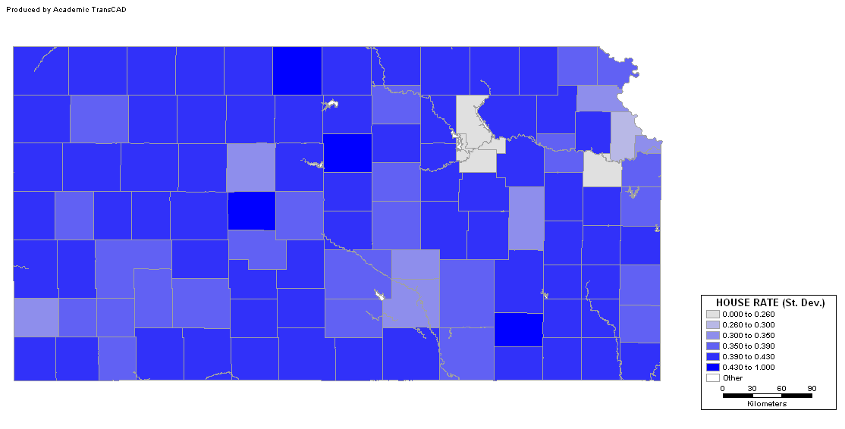
Exploring the Proportions
PrHOUSE (Std. Dev.)
Notes:
What is the advantage of using standard deviations?

Slide 20
Exploring the Proportions
PrINCOME (Std. Dev.)
Notes:
What is the advantage of using standard deviations?

Slide 21
Example
Bivariate analysis
  Scatterplots
  Correlation coefficients

Slide 22
Analysis of Residuals
Is variance constant?
  Scatterplot of errors vs. variables

Slide 23
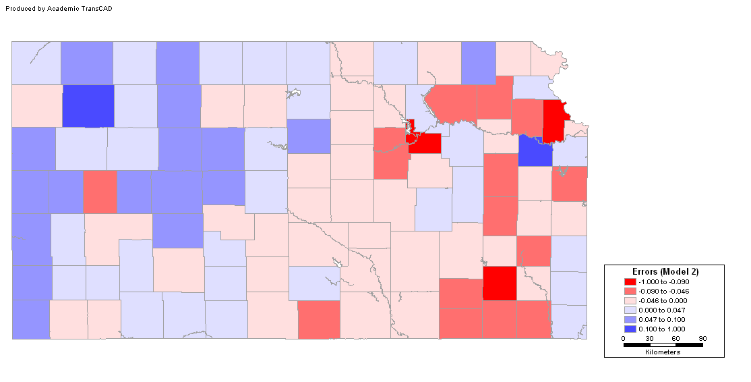
Analysis of Residuals
Are errors independent?
  Map of residuals

Slide 24
Analysis of Residuals
Are errors independent?
  Moran’s I
  Expected (mean) value of e is zero

Slide 25
Analysis of Residuals
Are errors normally distributed?
  Histogram
  Probability plot
  Other tests (Jaques-Bera, Kolmogorov-Smirnov,Lilliefors)

Slide 26
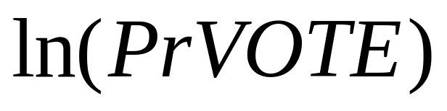
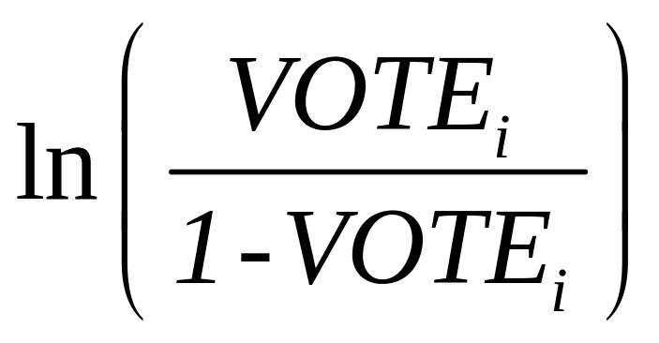
Variable Transformations
Other transformations
  Taking logarithms
  Logistic transform (generalized linear model)

Slide 27
Modeling Area Data
Data transformations
  Logarithm of proportional voter turnout:
  Correlation coefficients
  Model
  Analysis of residuals

Slide 28
Conclusion
Model selection
  Totals
  Proportions
  Logarithm of Proportions

Slide 29
Conclusion
All three models still show residual error pattern (error autocorrelation)

Slide 30
Next…
Area data III
  Spatial regression models
  Estimation of spatial models

